Slide 1

Unraveling Long Covid
CS 412
A Data Driven Approach to Understanding Symptom Patterns and Recovery Predictors
Manav Kohli, Anusha Kavatekar. Sammy Dandu, Abril Alvarez

Slide 2
Agenda
Machine Learning
1.
Problem Statement
2.
Data Set
3.
Methodology
4.
Results
5.
Challenges and Adaptations
6.
Conclusion

Slide 3
Problem Statement
Machine Learning
Long covid poses health challenges that need data driven insights
Our objective was to predict the likeliness of getting long covid in the United States ? (using specific characteristics: age, gender, intubation status, etc.)

Slide 4

CDC Long Covid Dataset
Dataset
Science Presentation
Long Covid Related Symptoms
The Dataset was on the long covid effects/deaths.
Data included:
Intubated - whether patient was connected to a ventilator
Gender
Age
Medical Unit
Diabetes
Pneumonia
Pregnancy
ETC.
Notes:
As part of an ongoing partnership with the Census Bureau, the National Center for Health Statistics (NCHS) recently added questions to assess the prevalence of post-COVID-19 conditions (long COVID), on the experimental Household Pulse Survey. This 20-minute online survey was designed to complement the ability of the federal statistical system to rapidly respond and provide relevant information about the impact of the coronavirus pandemic in the U.S. Data collection began on April 23, 2020.
Link - https://www.kaggle.com/datasets/meirnizri/covid19-dataset

Slide 5
Data Pre-Processing & EDA

Slide 6
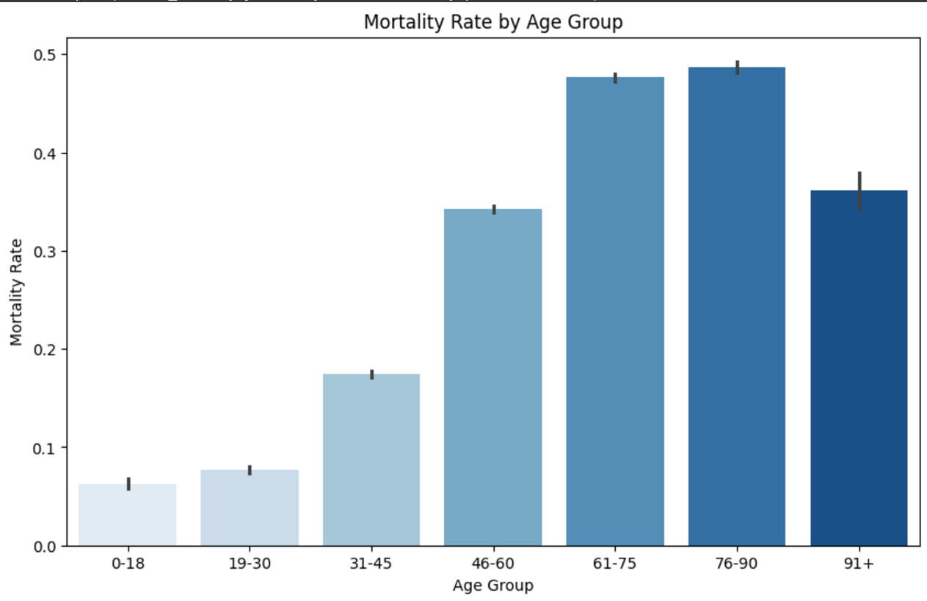
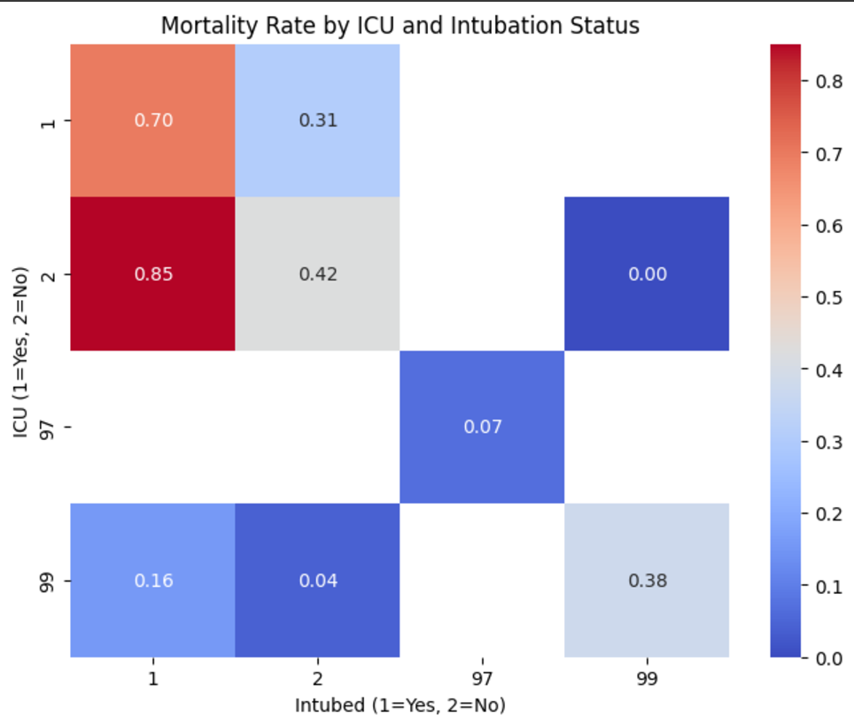
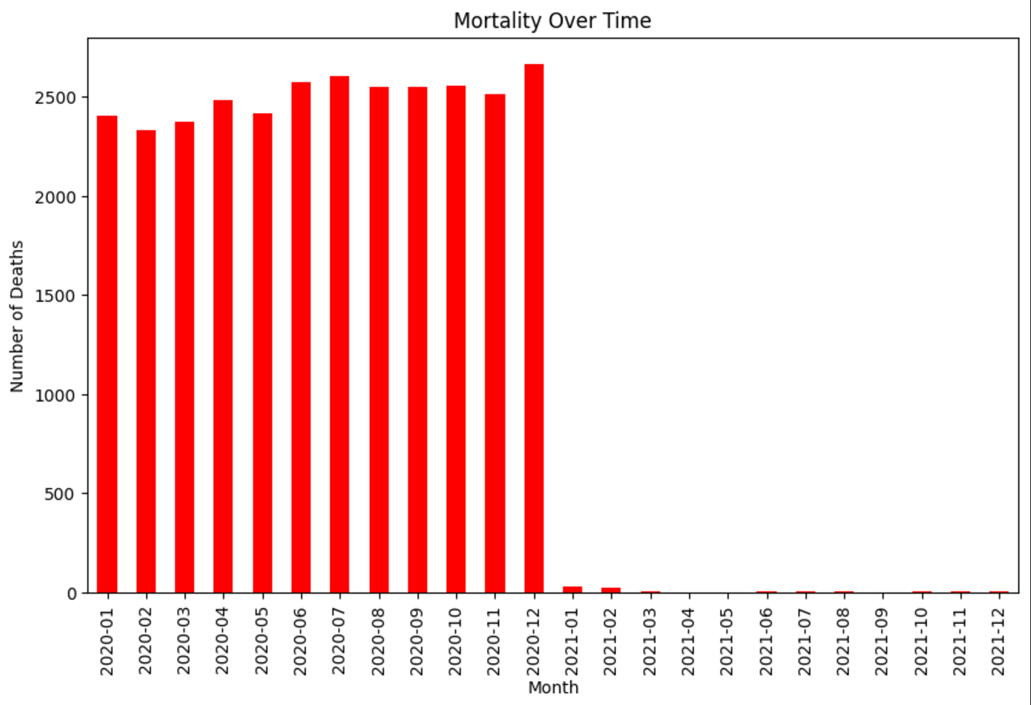
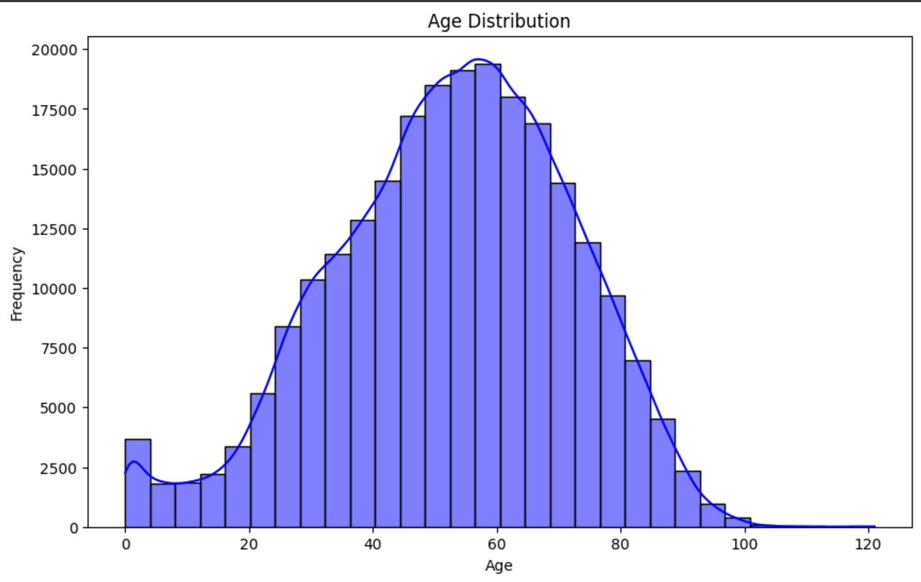
Pre-Processing + EDA
Pre-Processing:
Removed duplicates - balancing class balance + class proportions
Cleaned Missing Values - removing values with incomplete data
EDA:
Univariate distribution for age - most important factor for COVID mortality rate
Mortality rate by ICU and intubation status - strongly correlated
Age Distribution for COVID cases - normally distributed, as expected
Notes:
-cleaned missing values
- binary classification final: less than 4 didn't have covid, values greater than 4 had covid
dropped duplicates, ensuring class balance was the same and that class proportions were even
Univariate distribution - age distribution (age was the most important factor when determining mortality rate of COVID)
Mortality rate by ICU and Intubation status - this was done because the two factors were strongly correlated
Mortality rate over time and age group - wanted to see deciding factors, initial mortality rates were high ,dropped after end of 2020, start of 2021

Slide 7
Methodology

Slide 8
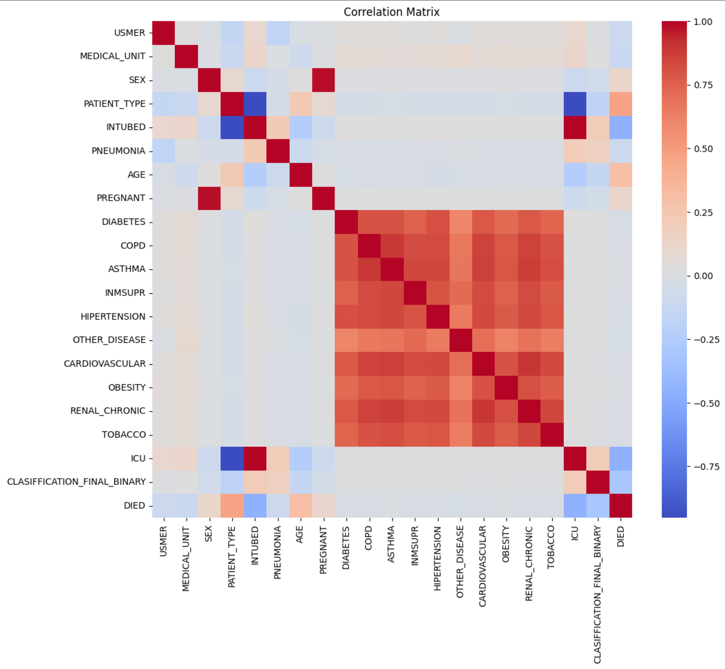
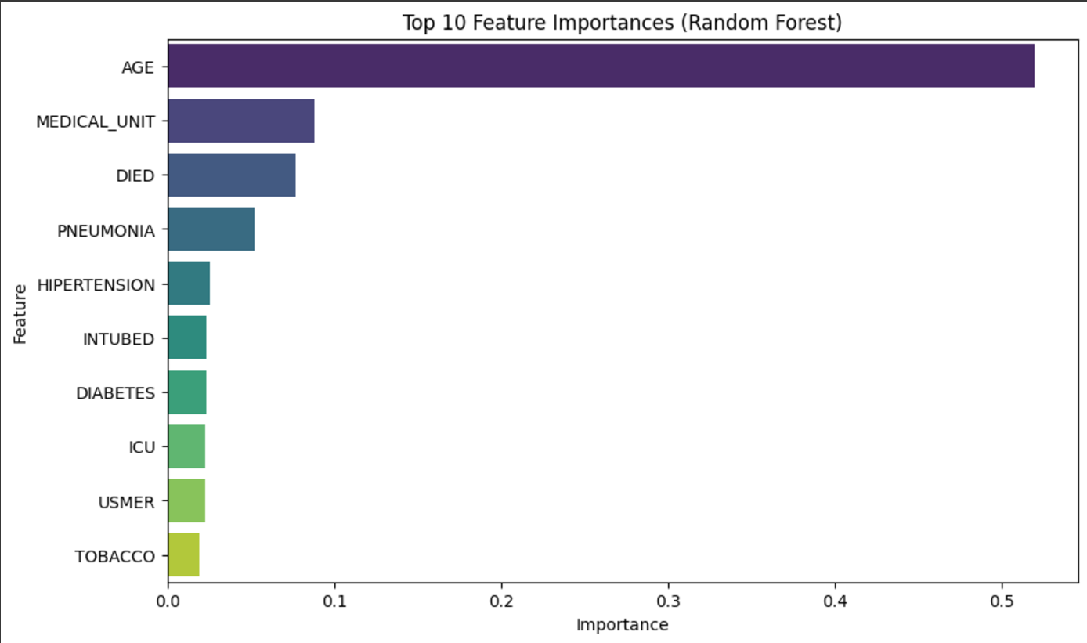
Feature Selection
Correlation Analysis:
Evaluated relationships between features using a correlation matrix.
Identified redundant or highly correlated variables for potential removal to reduce multicollinearity.
Feature Importance:
Utilized Random Forest to rank features by their predictive importance.
Key features like Age, Medical Unit, and Died emerged as significant predictors.
Dimensionality Reduction:
Insights from correlation and feature importance used to simplify the model.
Focused on top 10 most influential features for efficient model training and better interpretability.
Domain Expertise Integration:
Ensured feature selection aligned with domain relevance (e.g., clinical significance of Pneumonia, Hypertension, and ICU).
Optimization Goals:
Reduced overfitting risk by eliminating irrelevant/noisy features.
Enhanced model performance by prioritizing features with high predictive power.

Slide 9
Model Selection
Logistic Regression:
Serves as a baseline model for comparison.
Simplicity and interpretability make it a standard starting point for classification problems.
Useful for understanding the impact of individual features.
Random Forest:
Selected for its ability to handle non-linear relationships and feature interactions.
Robust to overfitting when tuned and provides insights into feature importance.
XGBoost:
Known for its state-of-the-art performance in structured data problems.
Highly efficient with built-in regularization techniques to reduce overfitting.
Often outperforms other models in classification tasks.
Voting Classifier:
Combines the predictions of multiple models to improve stability and accuracy.
Selected to explore the potential benefits of ensemble learning over individual models.
Neural Network:
Chosen for its ability to model complex non-linear relationships.
Particularly useful when features may interact in highly non-linear ways.

Slide 10
Results

Slide 11
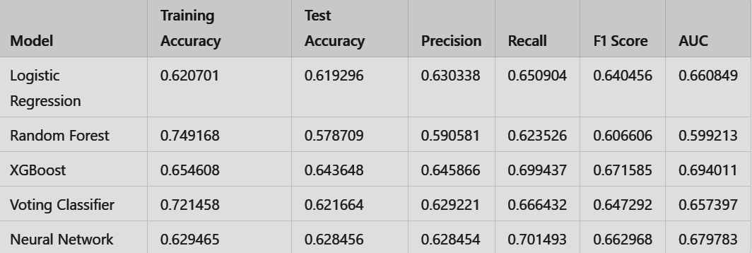
Preliminary Results
Logistic Regression:
Balanced performance across metrics.
Test Accuracy: 61.93%, F1 Score: 64.05%, AUC: 0.6608.
A good baseline model for comparison.
Random Forest:
High training accuracy (74.92%) indicates potential overfitting.
Lower test performance with Test Accuracy: 57.87% and AUC: 0.5992.
XGBoost:
Selected as the best model for its superior performance.
Test Accuracy: 64.36%, F1 Score: 67.16%, and AUC: 0.6940.
Strong balance between precision (64.59%) and recall (69.94%).
Voting Classifier:
Moderate results with Test Accuracy: 62.16% and AUC: 0.6574.
F1 Score (64.73%) slightly lower than XGBoost.
Neural Network:
Consistent but slightly behind XGBoost in overall performance.
Test Accuracy: 62.85%, F1 Score: 66.29%, and AUC: 0.6798.
Notable recall (70.15%) for identifying true positives.
Reason for Choosing XGBoost:
Best balance across all metrics.
Strong AUC and recall make it ideal for scenarios where minimizing false negatives is critical.

Slide 12
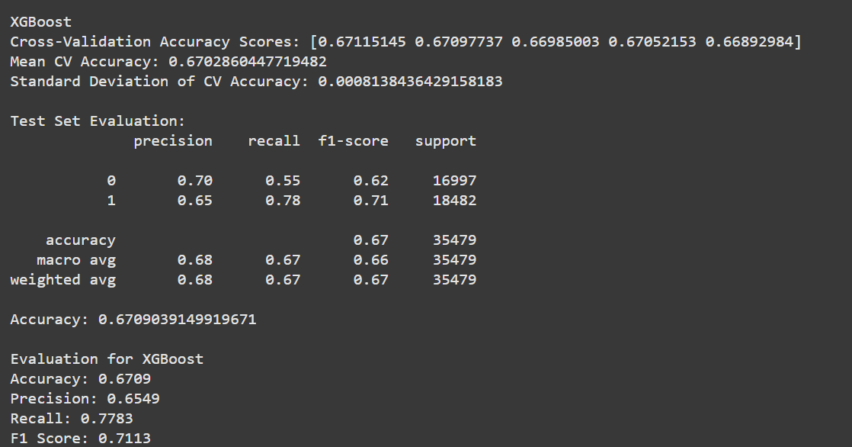
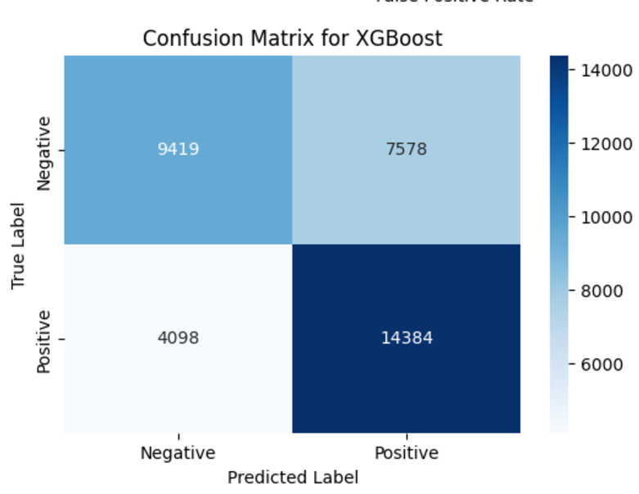
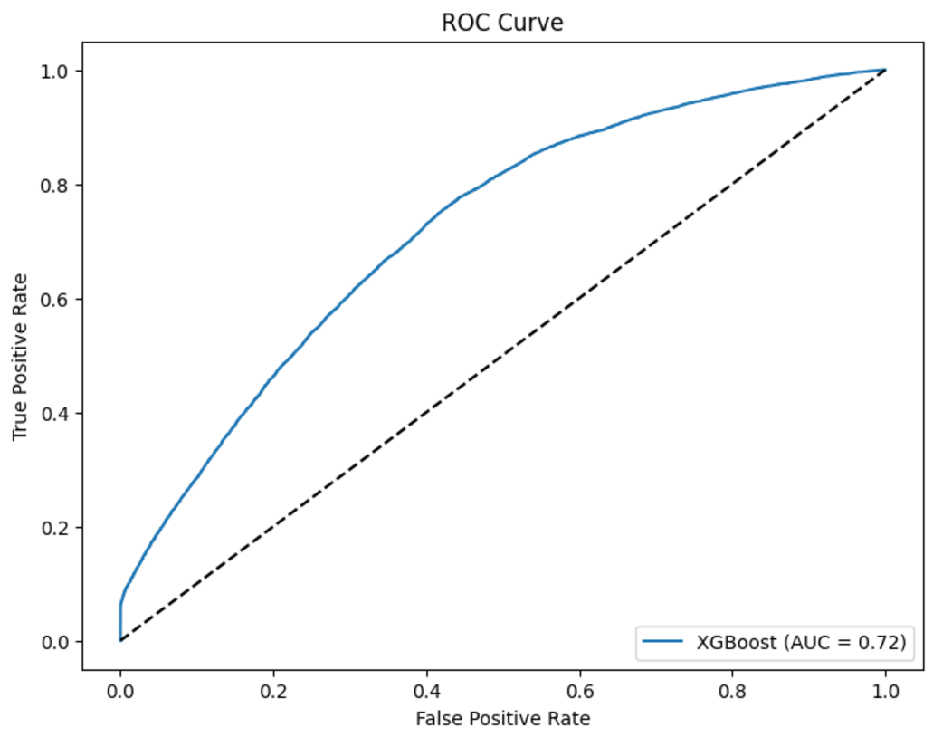
XGBoost Tuning & Results
Parameter Tuning:
max_depth: Configured to 6 to control the complexity of the trees and prevent overfitting.
learning_rate: Set to a low value of 0.01 to ensure gradual learning and avoid drastic updates.
Regularization: Applied both L1 (reg_alpha = 0.6) and L2 (reg_lambda = 0.6) to reduce overfitting and stabilize the model.
Cross-Validation:
Performed 8-fold Stratified Cross-Validation to ensure robust evaluation and mitigate overfitting.
Achieved a mean CV accuracy of 67.03% with a standard deviation of 0.0008, indicating consistent performance across folds.
Test Set Results:
Precision: 65% for the positive class, ensuring reasonable correctness in predicting positives.
Recall: 78% for the positive class, highlighting the model's effectiveness in capturing true positives.
F1 Score: Achieved a balanced score of 0.71, balancing precision and recall.
Overall Test Accuracy: 67.09%, consistent with cross-validation results.
Evaluation Metrics:
ROC Curve: Area Under Curve (AUC = 0.72) reflects a good trade-off between sensitivity and specificity.
Confusion Matrix:
True Positive: 14,384.
True Negative: 9,419.
Highlighted areas for improvement in reducing false positives (7,578).
Insights from Results:
Model shows strong generalization capability with consistent cross-validation and test results.
Recall and F1 Score make the model particularly effective for applications prioritizing minimizing false negatives.

Slide 13
Challenges and Adaptations

Slide 14
Challenges and Adaptations
Challenges
Noisy/Irrelevant Data in Dataset
Class Imbalance
Feature Engineering - needed to combine different features together for certain models which was difficult to do
Adaptations
Handled in Pre-processing by filtering out irrelevant data
Synthetic Minority Over-sampling Technique (SMOTE) - duplicating the existing minority samples to balance the distribution with the majority class

Slide 15

Real World Applications
Drawing a Conclusion
Science Presentation
BioInformatics Analysis used for medicine (Pharmaceuticals)
Doctors can use the predictive models to create personalized treatment plans.
Healthcare systems can better anticipate and allocate resources by understanding likely recovery trajectories.
Researchers can identify distinct subtypes of long COVID and evaluate treatments

Slide 16
Conclusion

Slide 17
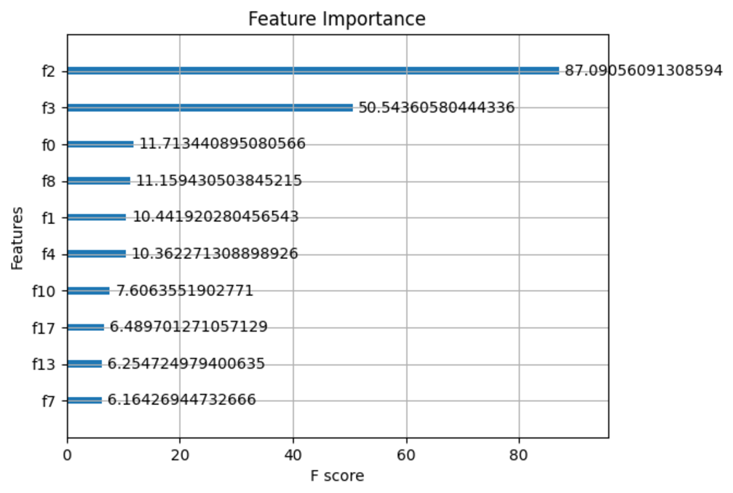
Our Findings and Future Steps
Key Findings:
XGBoost demonstrated the best balance between precision, recall, and overall performance.
Achieved consistent cross-validation and test set accuracy (~67%) with an AUC of 0.72, reflecting robust generalization.
Top features identified (Death, Age, Medical Unit, ICU, etc.) contributed significantly to model performance.
Implications:
High recall for positive class (78%) ensures effectiveness in identifying key cases, reducing potential false negatives in critical applications.
The regularization techniques used improved model stability and prevented overfitting.
Future Work:
Hyperparameter Tuning:
Experiment with advanced techniques like Bayesian Optimization or Grid Search for further fine-tuning.
Feature Engineering:
Incorporate domain-specific derived features to enhance predictive power.
Address potential feature redundancy based on correlation matrix insights.
Handling Imbalanced Data:
Explore techniques like SMOTE or class weighting to improve performance on minority classes.
Scalability:
Test model scalability on larger, more diverse datasets for broader applicability.
Potential Applications:
Deployment in real-world scenarios where high recall is critical, such as fraud detection or medical diagnoses.
Integration into a pipeline for real-time predictions, leveraging XGBoost’s computational efficiency.

Slide 18
Thank You!
Q/A

